Slide 1
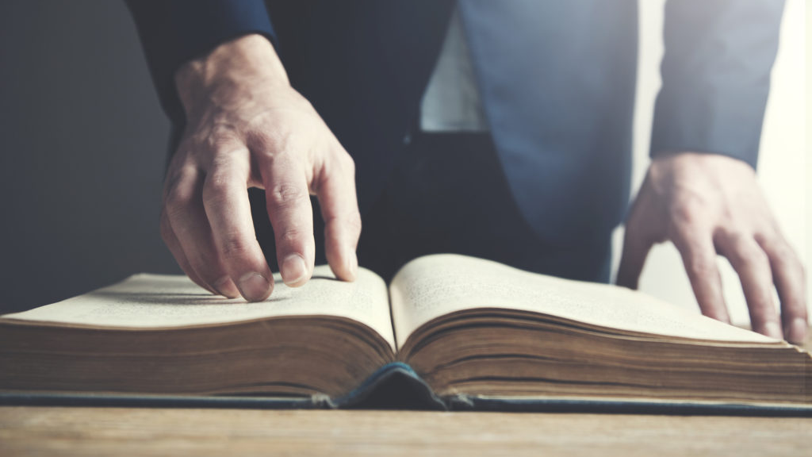
CALLED TO BE FAITHFUL: THE PATIENCE OF THE SAINTS
REVELATION 13:10

Slide 2
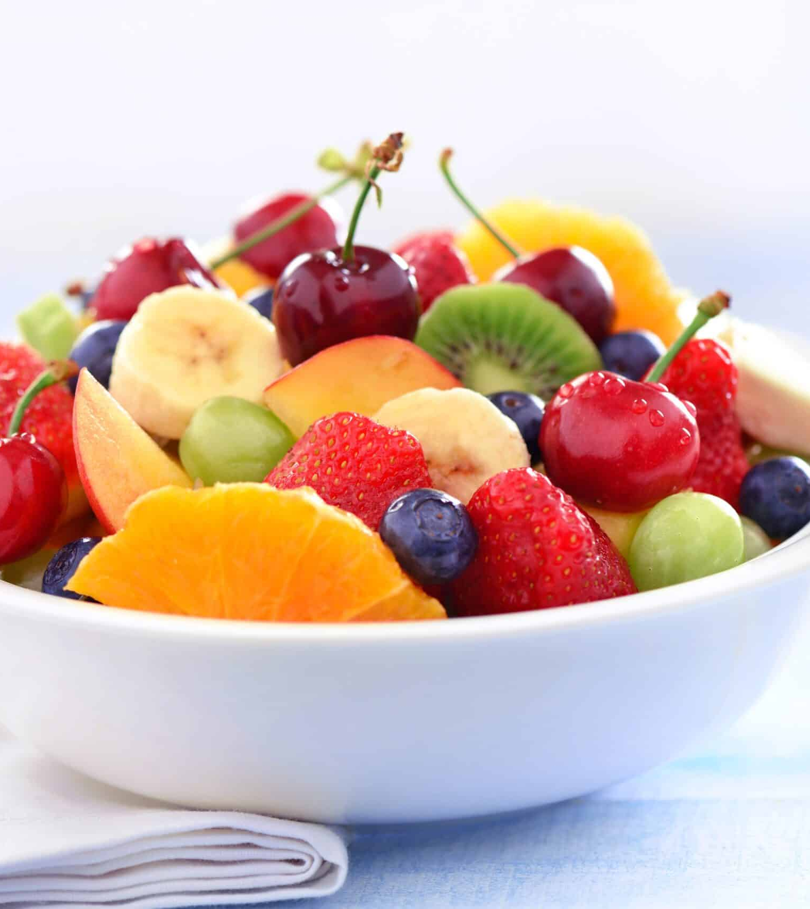
Introduction
Patience and faithfulness are included in the fruits of the Spirit. Galatians 5:22-23.
Patience may be the most powerful and difficult fruit to bear and yet if the Christian is patient with others as God is with us, we can help hold the door of Salvation open to others.

Slide 3
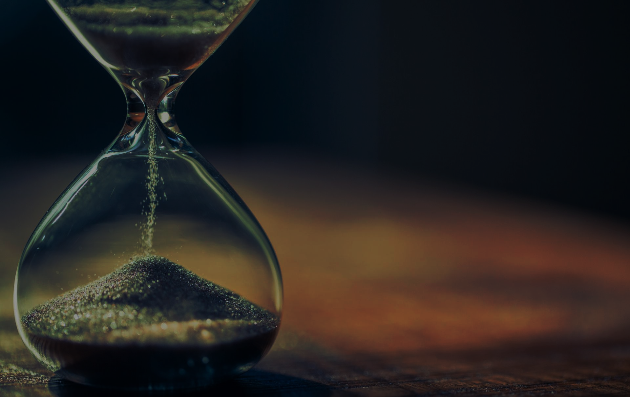
Patience is also the key to success in Christian life.
Patience and faithfulness do not come naturally but it is the gift from God bestowed on us as His fruits.
It is necessary that we cooperate with the Spirit as He develops patience and faithfulness within us because these can qualify and save us from the inevitable regrets that come when we refuse to wait in faith for His direction.

Slide 4

Why Patience?

Slide 5
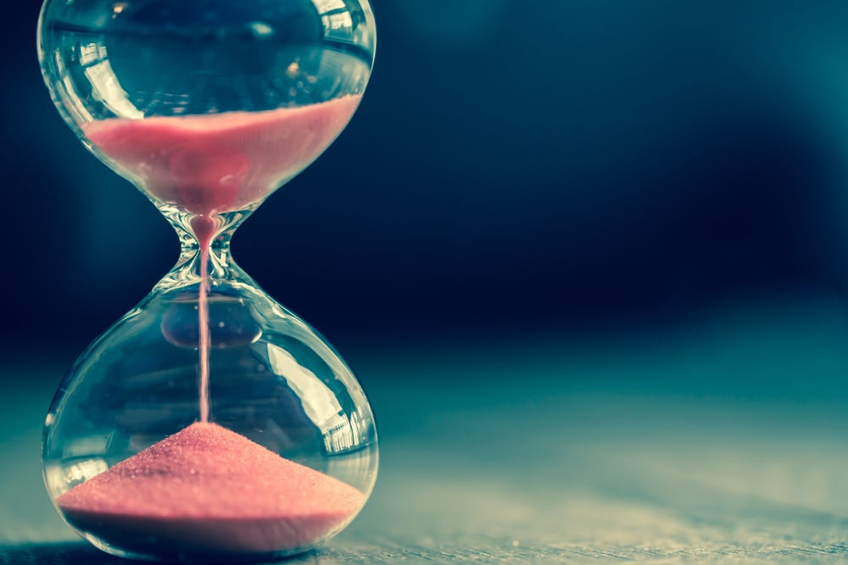
Patience is essential to experiencing God’s best.
Psalm 27:14, 32:8, 37:7 and 40:1.
King Solomon also in the wisdom of God contribute to it, Proverbs 31:5-6.
God created us to live for Him, serve Him and reflect Him.

Slide 6
Therefore, if what we desire does not fit with His purpose and timing, we would be foolish to insist on having it.
If God says no, He is not rejecting us but protecting us from an uncomfortable situation ahead of us.

Slide 7

Why Do We Need To Wait?

Slide 8

There are times we must make decisions, but we do not know what to do if God gives us a check in our Spirit to wait, we need to adhere to the promptings of the Holy Spirit.

Slide 9

Some of us are reluctant to delay and want God to act on our timetable.
However, we must remember that God is omniscient and knows everything about us and our circumstances. If He wants us to wait, it is because He knows the best.

Slide 10

What Is Required In Order To Live Obediently And Patiently?

Slide 11
What is required in order to live obediently and patiently?
Faith in God
A Spirit of Obedience
Discernment of God’s timing
Determination to wait
Notes:
Faith in God –We must believe that He will always direct us because He has promised to do so.
A Spirit of Obedience –To follow the Spirit’s guidance we must be willing to obey God and wait patiently
Discernment of God’s timing –The Holy Spirit guides us regarding the proper timing for our requests, and if it is not presently God’s will for us, He also gives us the grace to wait.
Determination to wait – In Psalm 32:8 God says ‘’I will instruct you and teach you in the way which you should go, I will counsel you with my eyes upon you’’. When we refuse to heed God’s counsel and plunge ahead in impatience, the outcome will never be what we intend. Waiting for as long as necessary until God in His wisdom tells us what to do is always a wiser decision and approach. Roman 8:25 – ‘’But if we hope for what we do not see, we wait for it with patience. Just as we believe in the Lord whom we cannot see’’.

Slide 12
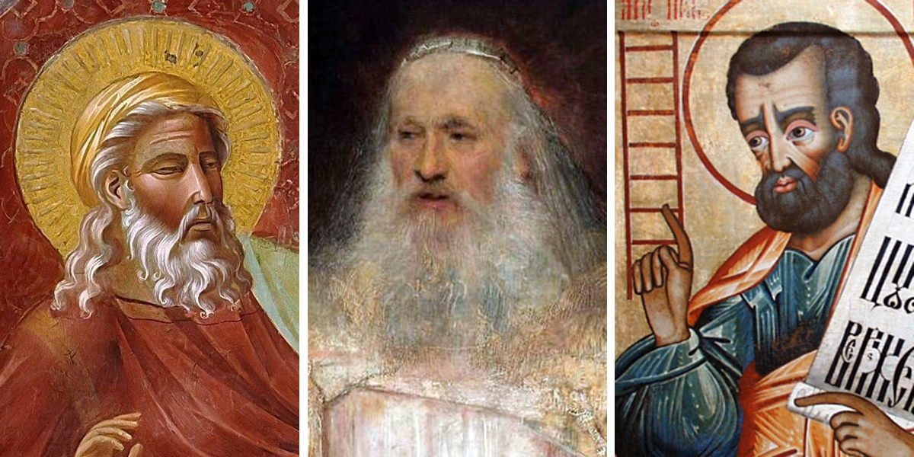
The faith of the Patriachs

Slide 13
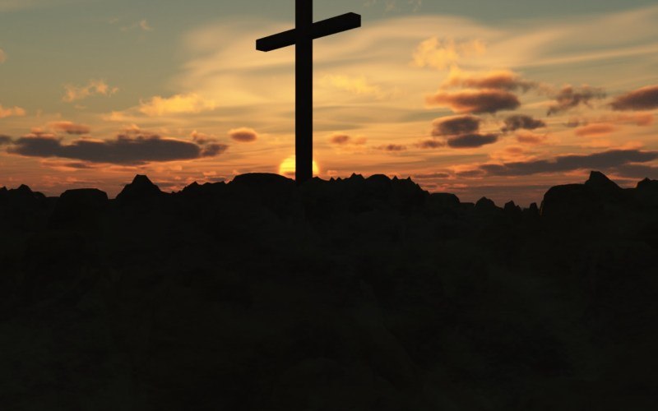
Faith is confidence or trust in a person, thing or concept. In the context of religion, faith is believed in God or in the doctrine, teaching of religion.

Slide 14
Though the patriarchs had individual stories, their successes depended highly on their faith. They trusted God and waited patiently for His directions.

Slide 15
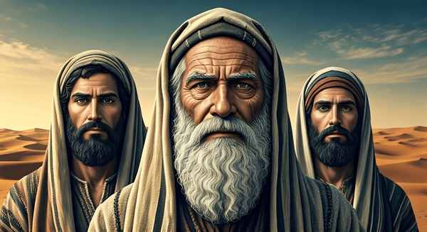
Abraham, Isaac, Jacob and Joseph had faith in God and it ended them in successes in different stories.
Hebrews 11:1
Galatians 3:6
Notes:
Hebrews chapter eleven tells us about the kind of trust they had in God (Yahweh). Hebrews 11:1 ‘’Faith is the substance of things hopedfor, and evidence of things not seen’’. Abraham believed God and it was accounted to him for righteousness.Galatians 3:6; No body can be righteous before God without being faithful.

Slide 16
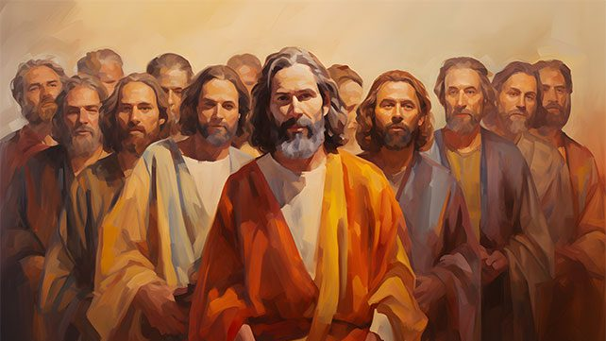
The faith of the Apostles

Slide 17

The religion of the apostles presents the orthodox Christian Church of today as a continuation of the life of the people of God since the beginning of creation.
Their faith centered around Christian way of life as distinguished them from non-Christians.

Slide 18

Luke 1:37
2 Corinthians 5:7
Romans 10:17
Hebrews 11:1

Slide 19
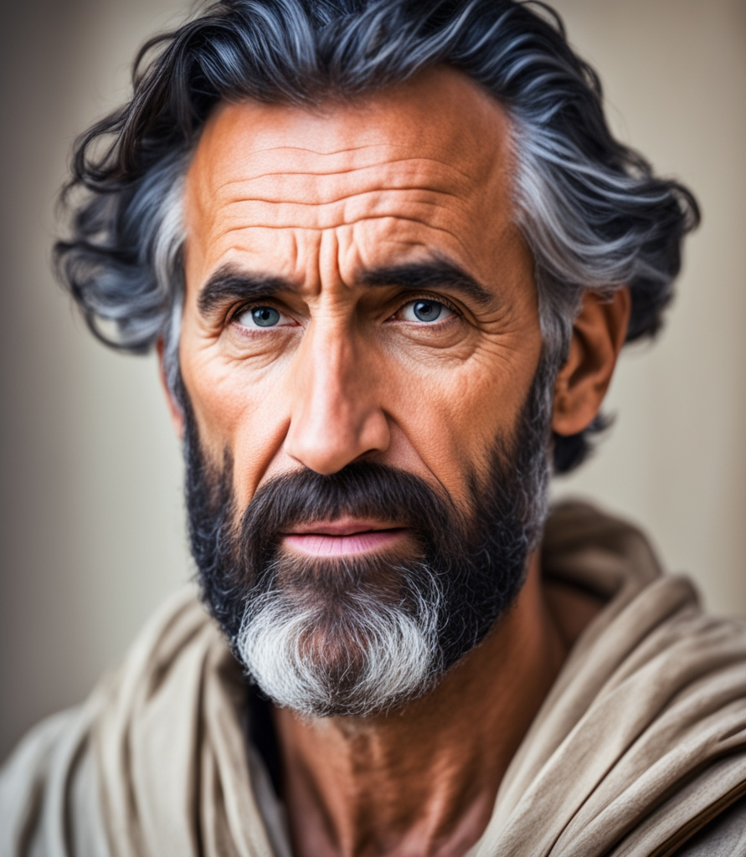
Apostle Paul teaches that faith is a wholehearted acceptance of Salvation through the atonement of Christ.
To place faith in Christ was to commit oneself into His care with a trust that naturally manifested itself in actions such as repentance, baptism and striving to live by the Spirit.

Slide 20
Characteristics of Faithfulness
Loyalty
Trustworthy
Steadfast in Love
Patience
Commitment
Endurance

Slide 21
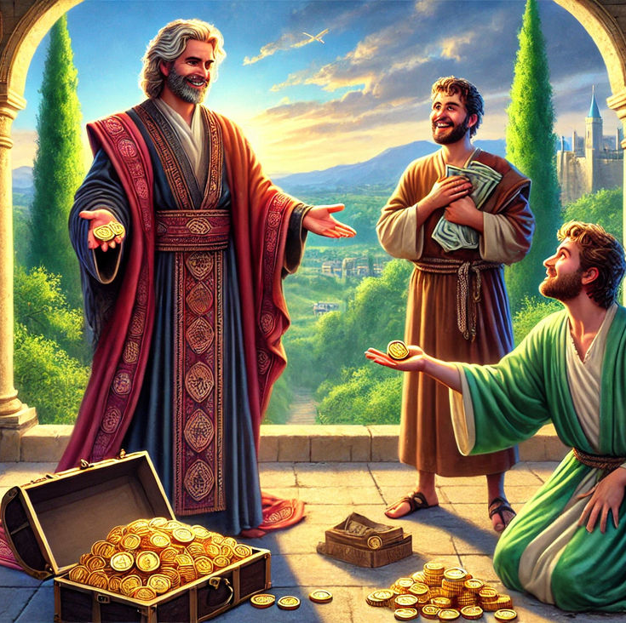
CONCLUSION
Faithful servants always do what pleases the master. Faithfulness in the little that the Lord has entrusted to our care has a great reward if we consider the parable of Mattew 25.

Slide 22
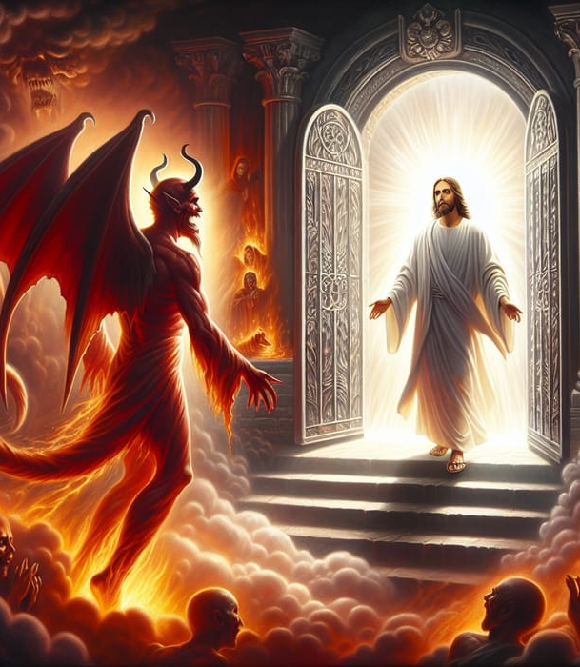
The great controversy between God and Satan is vividly spelled out in Revelation 13 where all Christians are obeying the dictates of the devil rather than God’s requirements as found in the bible.

Slide 23

The identity of Satanic power that Daniel and John wrote about is revealed. The power that changed God’s laws and has led the entire Christians astray.
God has an urgent message for this world which needs to be communicated by His chosen Church.

Slide 24
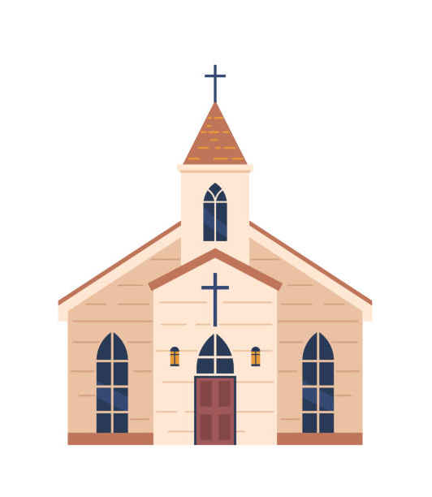
As Church of God, we need to be connected to Christ in faith and wait patiently for the guidance of the Holy Spirit so that in the end we could be counted among the righteous.
May God strengthen us individually and as a Church as we wait for His soon appearing.

